Slide 1
Problem Statement
A solution to improve product categorization in the catalog of an ecommerce websites or online stores.
Today, online stores and E-commerce websites have a list of products listed online. Many ecommerce and online stores face problem in producing interactive and useful results for user queries . This leads to loss of revenue and traffic on websites.

Slide 2
Product Categorization
It can be defined as the process that divides the products listed online into groups and subgroups.
Uses a three tier architecture :Super class, a family and a sub family. Lets take mobile as product to understand it
Super Class
Family
Sub-family
Electronics
(Mobiles)
Mobiles
(Samsung)
Subcategory
(Galaxy, S-series)

Slide 3
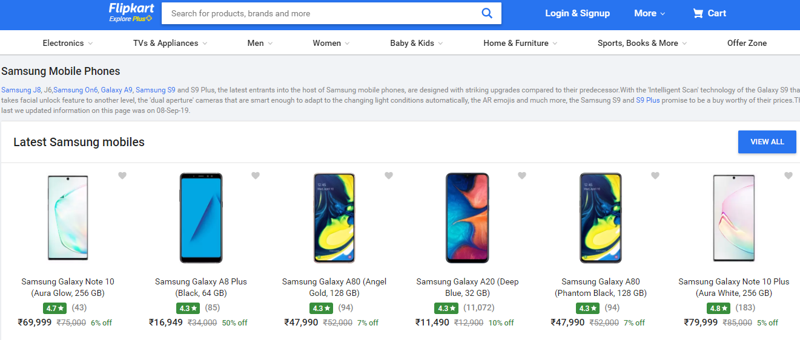
Figure shows super class, family & subfamily
Figure shows super class, family and subfamily

Slide 4



How it is useful?
A well structured product categorization provides the following benefits:
Better Searching
Increased Revenue for ecommerce
Better user experience
Improved reporting and analysis
Removal and detection of duplicate products

Slide 5
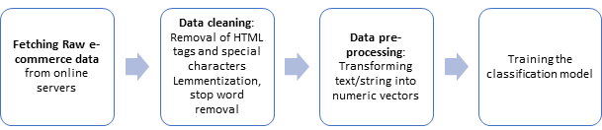
Methodology

Slide 6
Tools and technologies
Gensim
NLTK
Python
Tools and Technologies
Extracts semantic topics
Python library
Natural language processing
Python Package

Slide 7
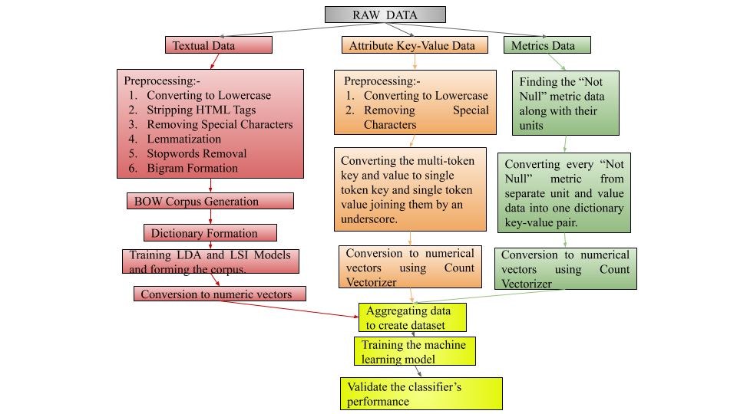
Training Process (Detailed Methodology)

Slide 8
Preprocessing of textual data
Converting the whole text to lowercase
Stripping HTML tags
Lemmatization
Replacing special characters by blank space
Removing Stop Words
Forming bigrams and phrases

Slide 9
Preprocessing of attribute key value data
3
2
Converting the data to lowercase
Removing the special characters
Converting the text in the key-value pairs
1

Slide 10
Metrics and Dimensions Data
For preparing the data for metrics, we created a list of dictionaries, in which each dictionary holds data like {‘product_length’:[100.0, ‘cm’]}. Such a key-value pair is generated from raw data that looks like as follows {‘product_length’:100.0,‘product_length_unit’: ‘cm’}.
After cleaning and pre-processing the text/string data into numeric vectors, the machine learning model was trained and then validated for its performance.

Slide 11
Analysis
Libraries used
NLTK
Gensim
Sklearn
Numpy
Pandas
Seaborn
For unsupervised topic modeling and natural language processing
It features various classification, regression and clustering algorithms including support vector machines, random forests.
For data manipulation and analysis. In particular, it offers data structures and operations for manipulating numerical tables and time series.
Adding support for large, multi-dimensional arrays and matrices
It provides a high-level interface for drawing attractive and informative statistical graphics.
For symbolic & statistical natural language processing for English written

Slide 12
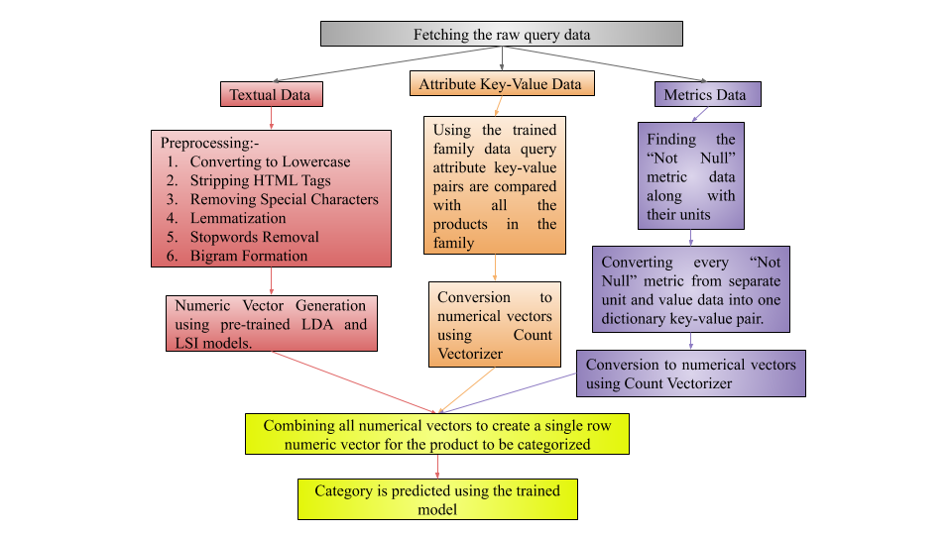
Evaluation

Slide 13
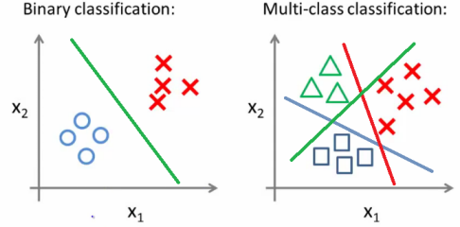
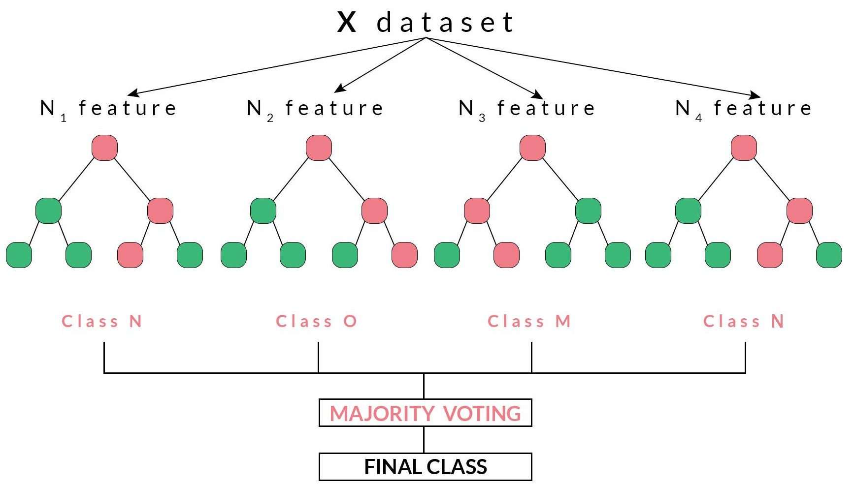
Classification : By Random Forests
As this is a supervised learning and multi-classification task.
Random forest method is used for classification task.

Slide 14
Reasons & advantages of Random forest
Has less variance than a single decision tree. It means that it works correctly for a large range of data items than single decision trees.
Extremely flexible and have very high accuracy.
Do not require preparation of the input data.
No need to scale the data
Maintains accuracy even when a large proportion of the data are missing.
A single decision tree tends to over fit the data. The process of averaging or combining the results of different decision trees helps to overcome the problem of overfitting.

Slide 15
Continue..
The training data is segregated into independent and dependent variables and then is splited into training and testing set.
50% Training – 50% Validation data of total data.
The training dataset of the size (47500 X 176216) is fed to Random Forest and training is done
Took 19 minutes to train the whole model.
Output is tested against validation data for comparison.

Slide 16
RESULTS
The accuracy of the model is around 88%.
Mean precision = 0.868
Mean recall = 0.868
Mean f1-score = 0.867
Mean support = 250.0

Slide 17
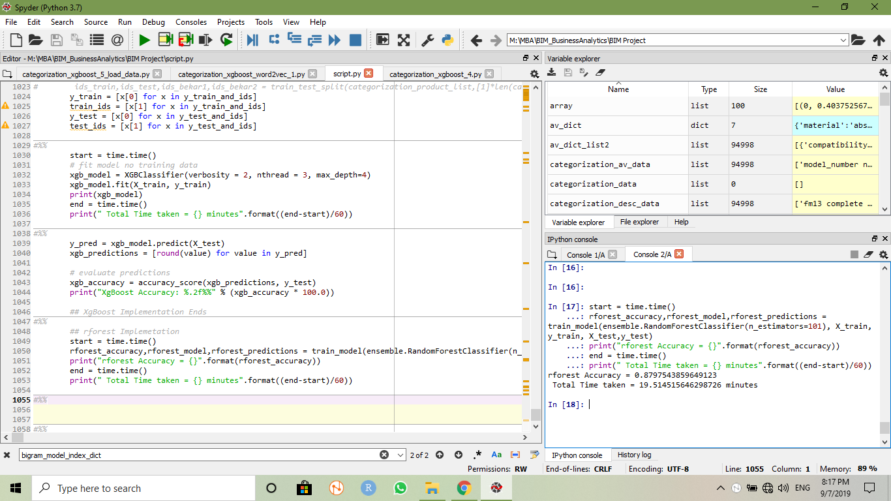
Figure shows accuracy of model

Slide 18
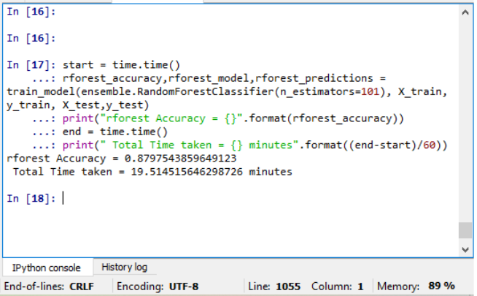
Figure shows result of model

Slide 19
Interpretation of the results
In our model, we had 190 classes with each class having an approximate 500 products. So the total data was around 10000.
The random forest algorithm that was run gave an accuracy of 87.9% and took a total time of 19.51 minutes.
We can interpret that out model was very good because data was huge and it provide good accuracy in less time to train data.

Slide 20
Outcome of results
As algorithm results in right classification of products , it will help in increasing revenue and enhanced user experience.
Prevent seller from tricking the system to capture buy box and increase transparency in system.
Help in detecting duplicates using minimum defining attributes.

Slide 21
References
Python Official Website - https://www.python.org/
Gensim LDA Model - https://radimrehurek.com/gensim/models/ldamodel.html
Gensim HDP Model - https://radimrehurek.com/gensim/models/hdpmodel.html
Gensim LSI Model - https://radimrehurek.com/gensim/models/lsimodel.html
NLTK Official Website - http://www.nltk.org/
https://stackoverflow.com/questions/19233771/sklearn-plot-confusion-matrix-with-labels/31720054
https://scikit-learn.org/stable/modules/generated/sklearn.metrics.precision_recall_fscore_support.html

